Slide 1
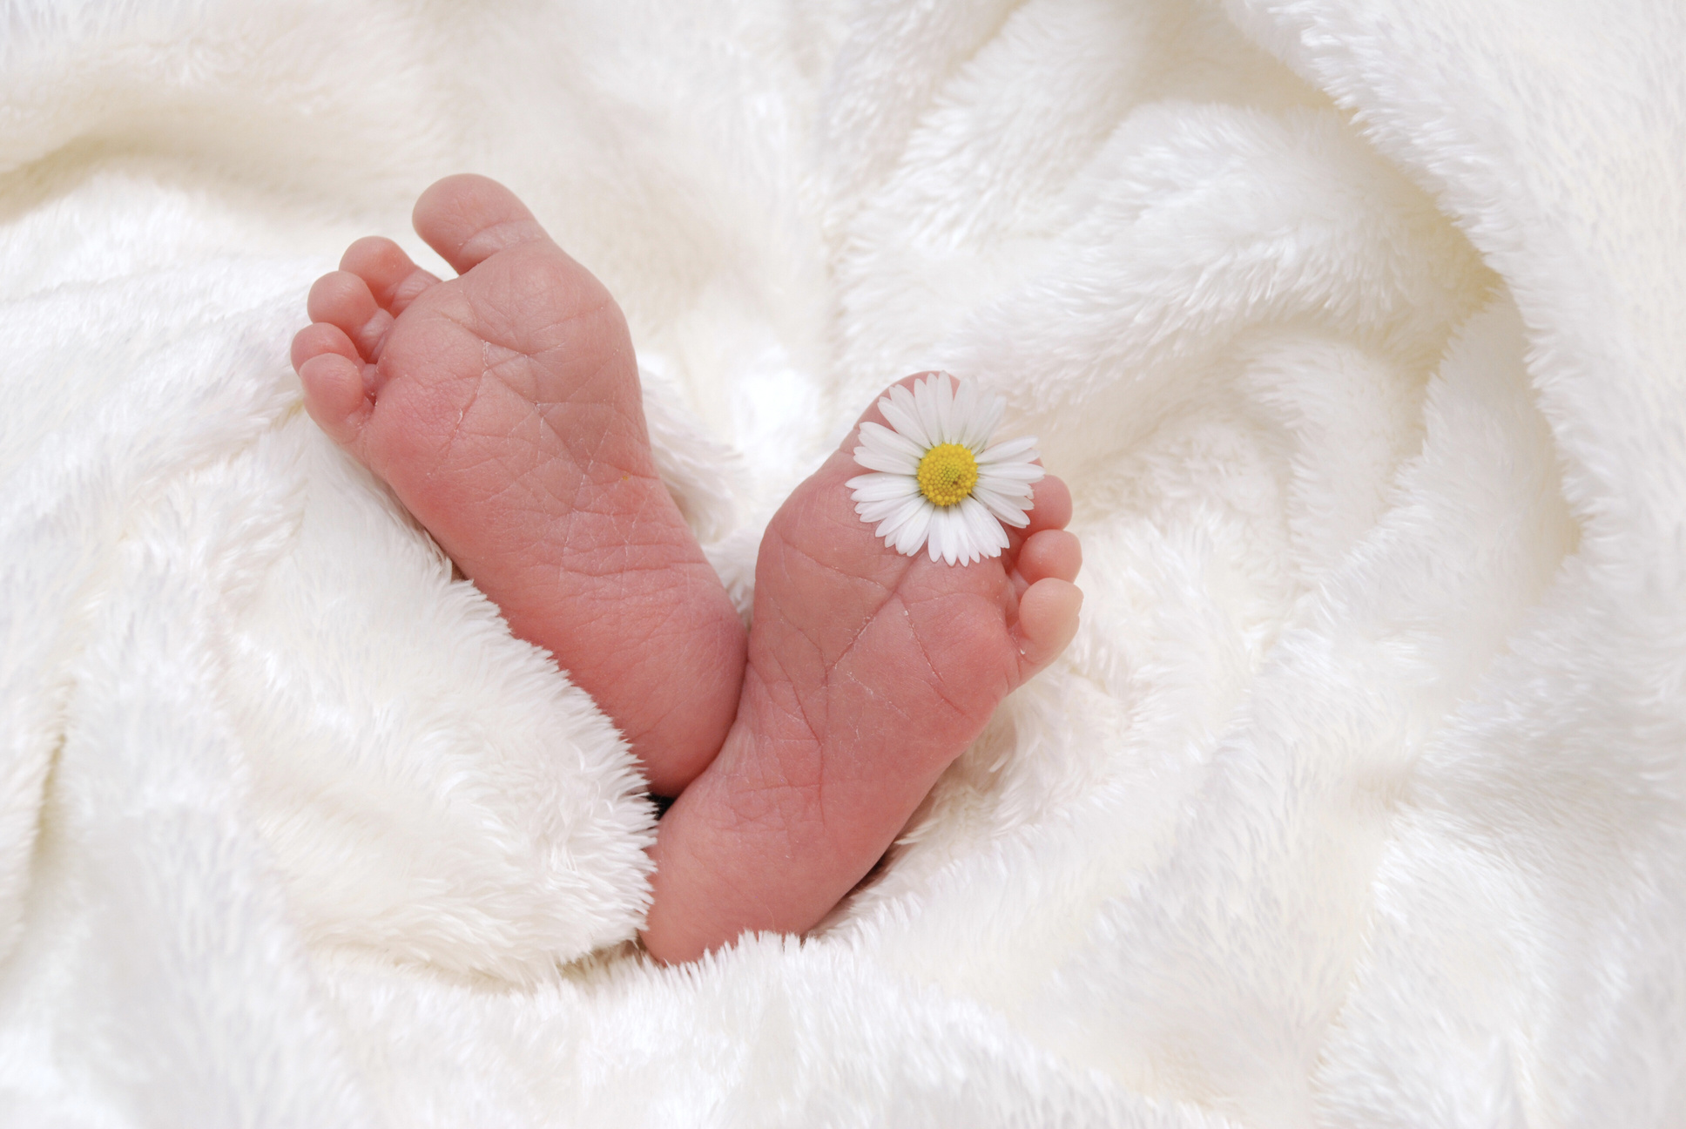




Baby dedication certificates
NAME OF BABY
HAS BEEN DEDICATED TO THE LORD ON THE 10TH DAY OF JULY IN THE YEAR 2030 AT HOPE FELLOWSHIP CHURCH
PASTOR’S SIGNATURE
HOPE FELLOWSHIP CHURCH

