Slide 1
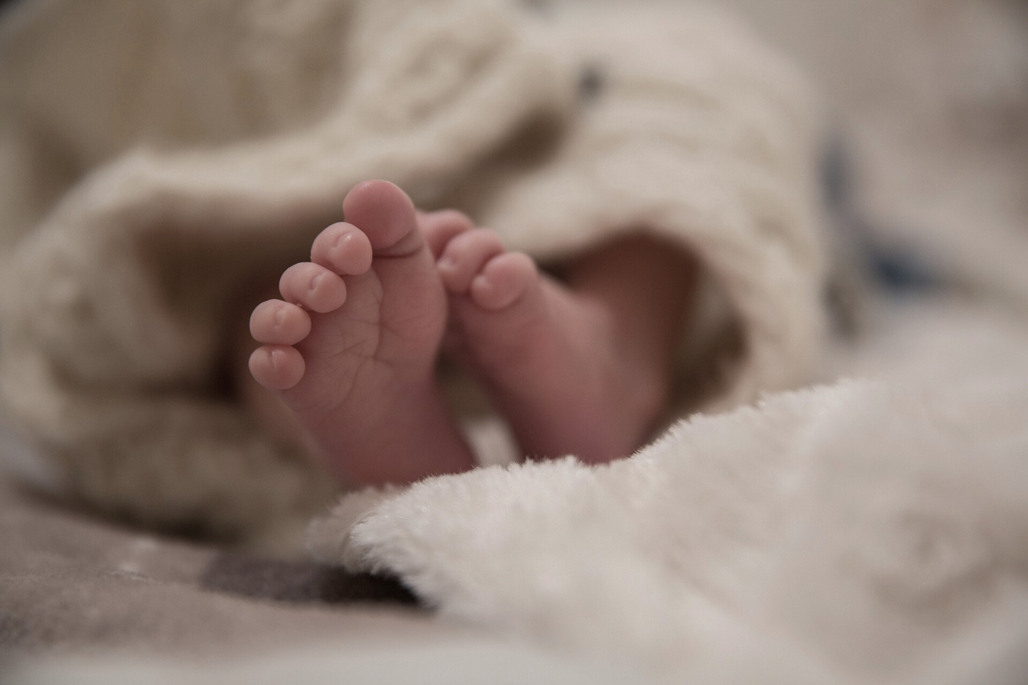

HOPE FELLOWSHIP CHURCH
Baby dedication
CERTIFICATES
THIS CERTIFICATED IS PRESENTED TO
XYZ
has been dedicated to the lord on the 10th day of July in the year 2030 at Hope Fellowship Church
— JOHN 3:16
For God so loved the world, that he gave his only begotten Son, that whoever believes in him should not perish, but have everlasting life.
HOPE FELLOWSHIP CHURCH
Pastor’s Signature

