Slide 1


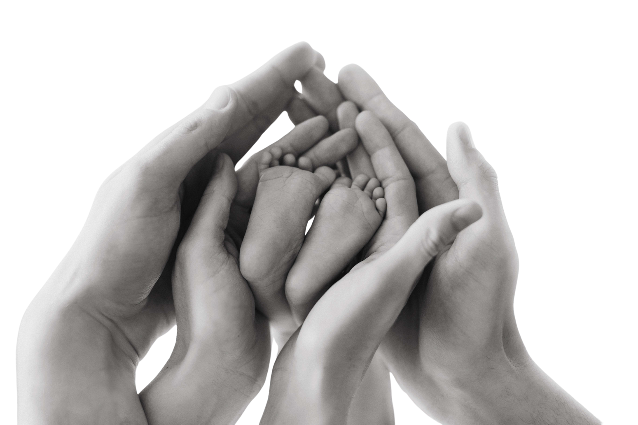

Baby dedication
certificates.
WAS LOVINGLY DEDICATED TO GOD
ON
OF
AT
SIGNATURE
SIGNATURE
— JOHN 3:16
For God so loved the world, that he gave his only begotten Son, that whoever believes in him should not perish, but have everlasting life.

